Slide 1


DEMAND AND SUPPLY ANALYSIS
PROJECT
TOPIC : ENERGY SUPPLY AND DEMAND ANALYSIS

Slide 2

CONTENT
01
INTRODUCTION
02
ENERGY SUPPLY OVER TIME
03
SOLAR VS WIND ENERGY GENERATION
04
SUPPLY AND DEMAND CURVES OVER TIME
05
BOX PLOT OF ENERGY PRICES BY MONTH
06
BAR PLOT FOR ENERGY GENERATION BY SOURCE
07
CONCLUSION

Slide 3




INTRODUCTION
Energy is a vital resource that drives economies and sustains societies. Analyzing the intricate interplay between energy supply and demand is crucial for optimizing resource allocation, ensuring energy security, and mitigating environmental impacts.
Energy markets are complex ecosystems influenced by diverse factors such as technological advancements, regulatory frameworks, geopolitical dynamics, and consumer behavior.

Slide 4

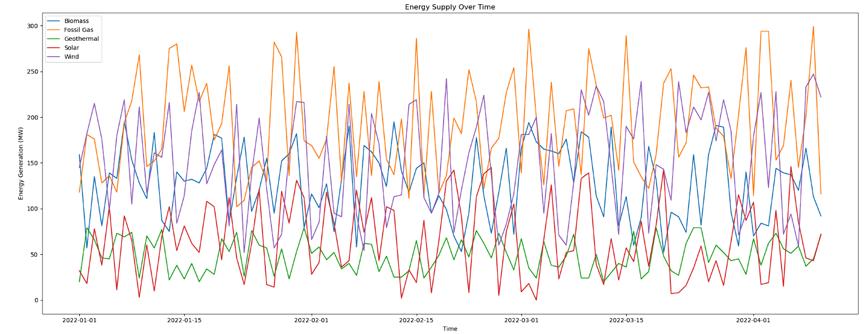
ENERGY SUPPLY OVER TIME

Slide 5
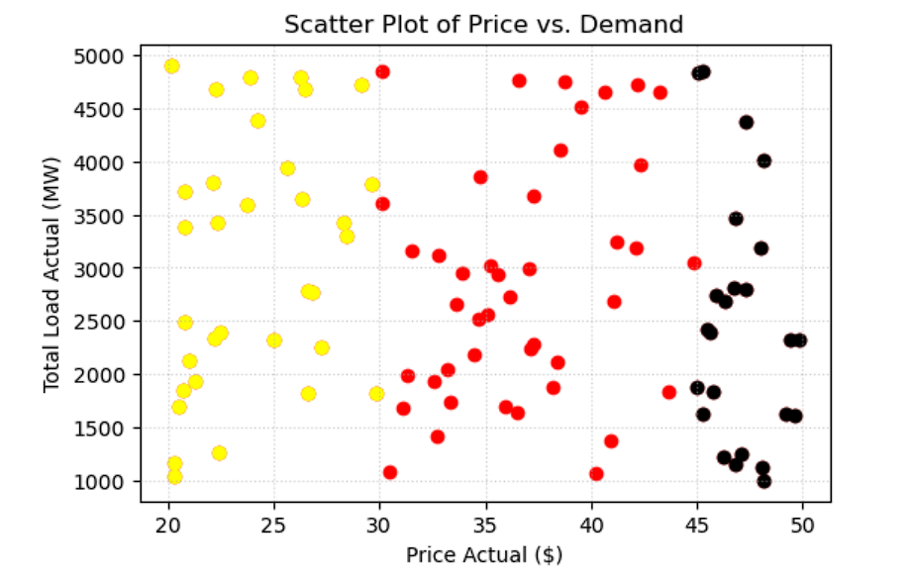
SOLAR VS WIND ENERGY GENERATION

Slide 6
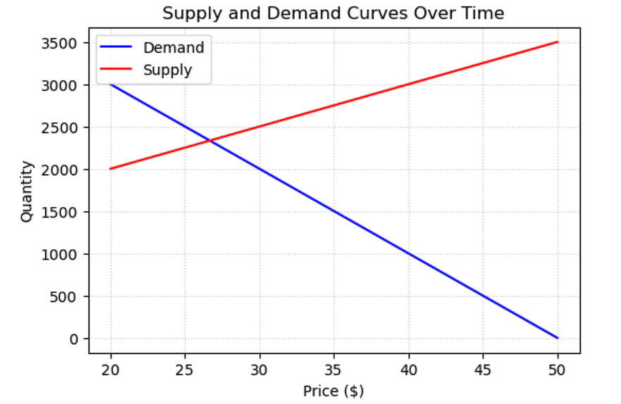
SUPPLY AND DEMAND CURVES OVER TIME

Slide 7
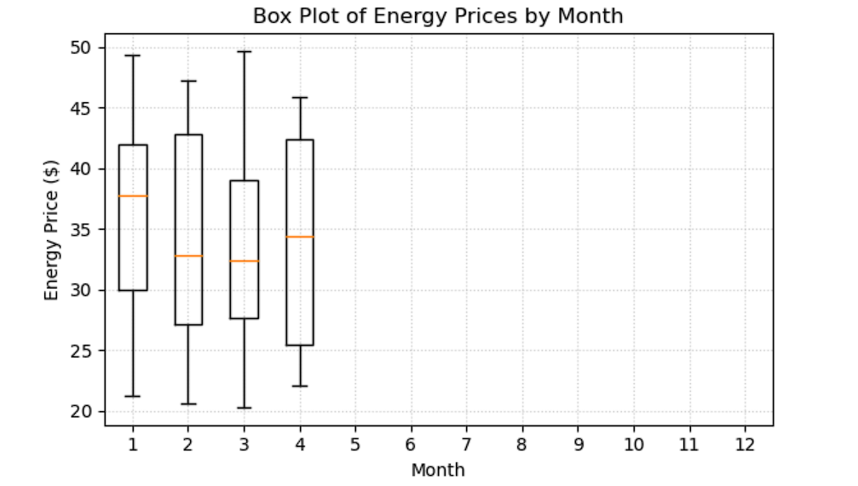
BOX PLOT OF ENERGY PRICES BY MONTH

Slide 8
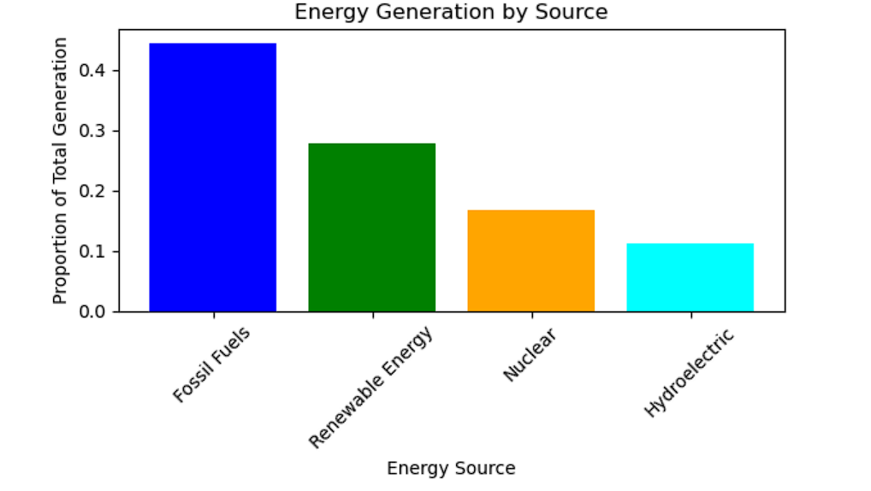
Bar Plot for Energy Generation by Source

Slide 9
OUR TEAM
2105010
2105019
2105021
2105066
2105072
Ankit Singh
Ark upadhyay
Aryan Deo
Shakshi Kumari
Srijan Raj

Slide 10


THANK YOU

